Slide 1
AVENGERS
AMES HOUSE PRICE

Slide 2
BACKGROUND OF STUDY
The average house price in Ames was $180,921 were found by a study conducted in August 2020 and the prices were influenced by quality of house, neighbourhood, size of the house. Over the course of the year, the selling price could result in additional costs over $800,000 and lead to different factors influenced it.
Research in 2011 explained that, some families need to measure and determine how much money they have in order to achieve an acceptable standard of living. Consumers need to adjust their preference of house based on their budget.

Slide 3
CONTENTS OF THIS CASE STUDY
Here’s what you’ll find in this study:
Data Description
Problem Statements
Exploratory Data Analysis
Research Methodology
Results and Findings
Demonstration Video

Slide 4
DATA DESCRIPTION
ABSTRACT
2930
DATA SIZE
81
FEATURES
Data from Ames Assessor’s Office for individual residential properties sold in Ames, IA from 2006-2010
Total number of observations in the data set.
23 nominal, 23 ordinal, 14 discrete, 20 continuous variables and 1 identifier

Slide 5
PROBLEM STATEMENTS
DEVELOPER’S
CONSUMER’S
Find factors that affecting sale price of house in Ames, IA.
Determine the estimated market house price in Ames to avoid selling it with overpriced value.
AVENGERS
Help customer to choose a house based on their preferences and budget.

Slide 6
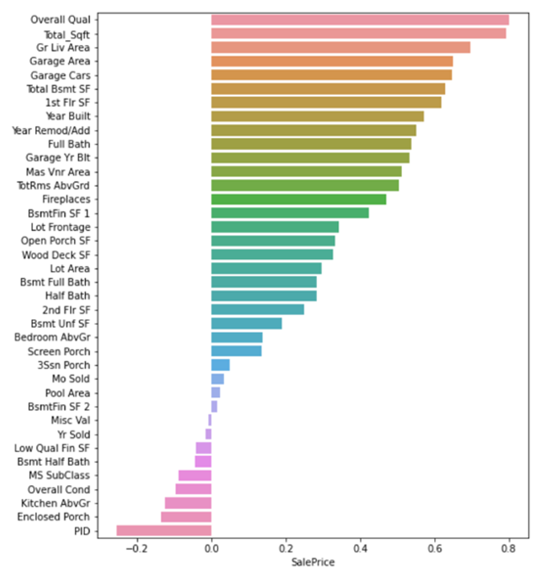
Data Exploratory Analysis
81
2930
43
38
Number of columns
Number of rows
Number of object data
Number of object data

Slide 7
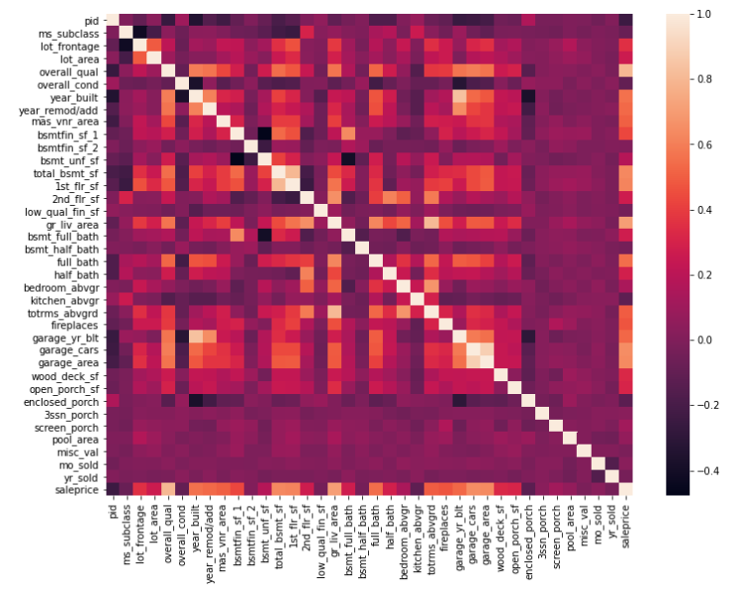
Correlated features and its data
Features | Correlation
overall_qual | 0.799262
gr_liv_area | 0.706780
garage_cars | 0.647877
garage_area | 0.640401
total_bsmt_sf | 0.632280
1st_flr_sf | 0.621676
year_built | 0.558426
full_bath | 0.545604
year_remod/add | 0.532974

Slide 8
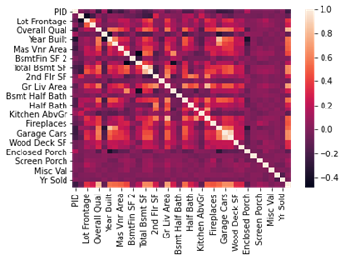
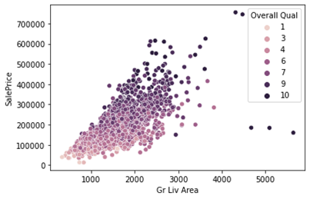
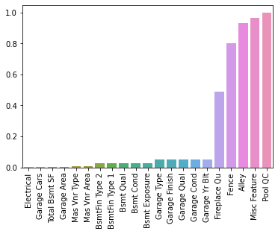
METHODOLOGY
1. CORRELATION
2. OUTLIER
3. MISSING DATA

Slide 9
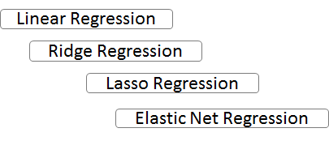
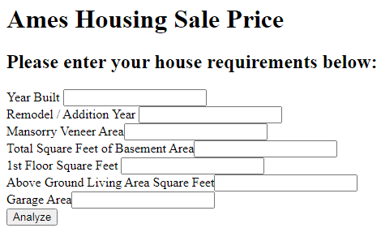
METHODOLOGY
4. DATA ENCODING
5. MODEL TESTING
6. MODEL DEPLOYMENT
Ex Excellent 4
Gd Good 3
TA Average/Typical 2
Fa Fair 1
Po Poor 0

Slide 10
SOLUTIONS
So, what is the Solution???
Web application that able to predict up to 88% accuracy
Only using 13 important features
Consumers able to tweak the features freely based on their preferences

Slide 11
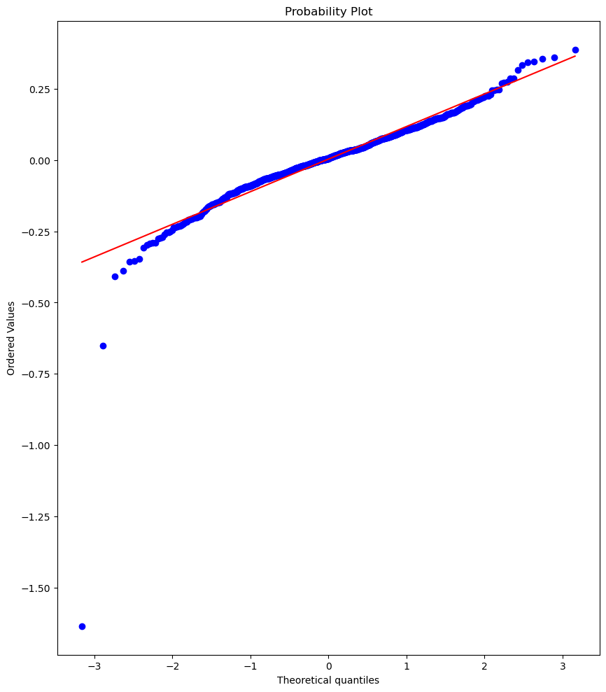
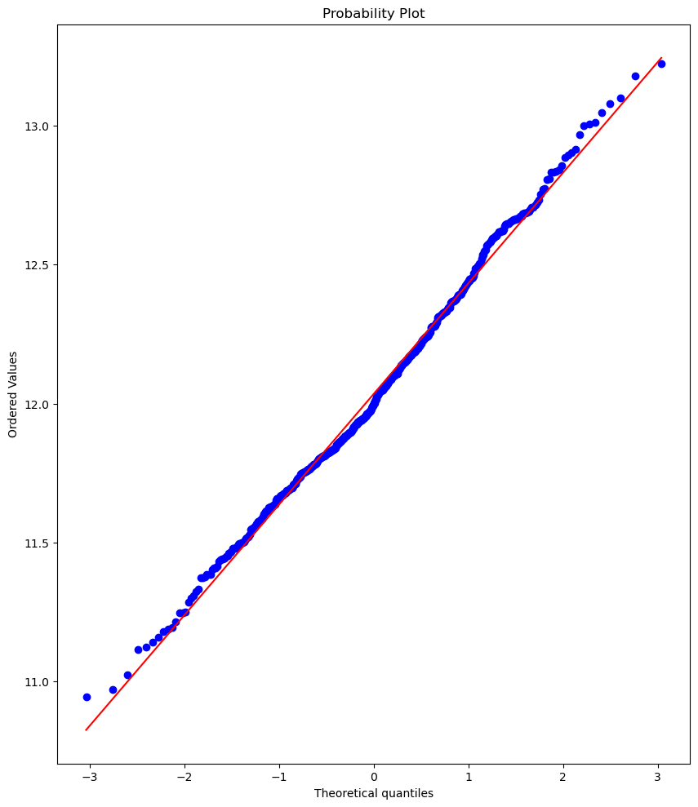
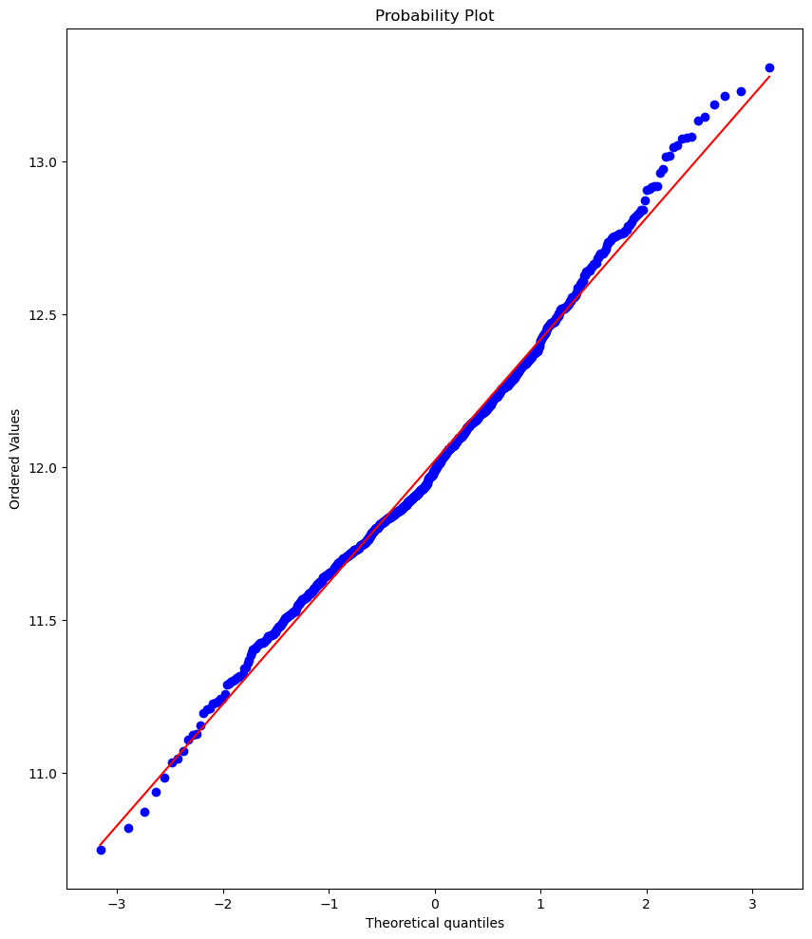
COMPARING THE MODEL
MODEL 1
RIDGE
MODEL 3
RIDGE CV
MODEL 2
LASSO CV
It reduce the overfitting, but had a lot of features used. Model would be too complex
ACC = 93%
ACC = 91%
ERROR
PERCENTAGE
= 0.65%
ACC = 92%
ERROR
PERCENTAGE
= 0.71%
ERROR
PERCENTAGE
= 2.56%
RMSE = 0.12
RMSE = 0.10
RMSE = 0.12

Slide 12
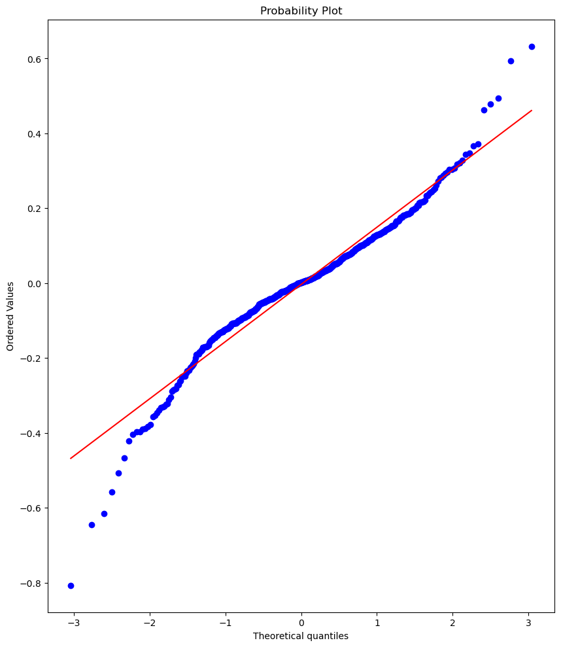
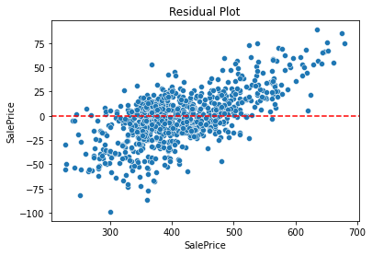
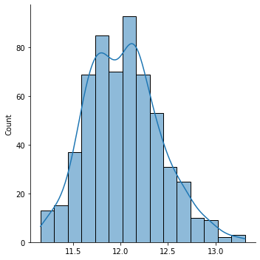
SELECTING THE BEST MODEL (FINAL MODEL)
LASSO CV
ACC = 88%
less features, less complex
use only 13 important features
adding some bias in the model to reduce overfitting
ERROR
PERCENTAGE
= 0.94%
RMSE = 0.15

Slide 13
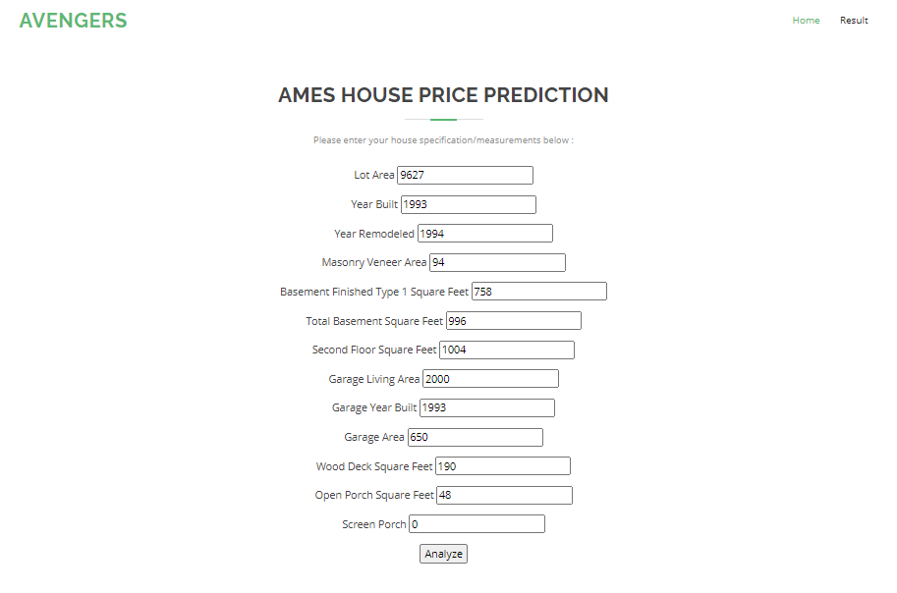
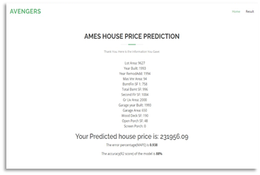
HOW TO USE IT??
Fill in the form with preferred value according to its respective units
Click the ‘Analyze’ button to generate the prediction
return the predicted sale price along with the filled value for checking
It also returns the percentage error and accuracy of prediction

Slide 14

WEB APP DEMO

